Slide 1

Big Data project of team XLARGE
Music Recommendation
Seunggeun Baek | Jihoon Bae | Junhu Kang | Nawon Kim | Yujin Jang
Notes:
Good afternoon. We are Xlarge. Project topic is Music Recommendation. Teammates are Seunggeun | Jihoon | Junhu | Nawon and Yujin

Slide 2
I n d e x
Introduction
Used Data
Used skills
Conclusion
Notes:
I will tell you introduction, used data, and just one model. And then, Junhu will tell you from other models to conclusion.

Slide 3

01
Introduction
Intro
duction
Used
Data
Used
Skills
Con
clusion
Title KKBox’s Music Recommendation Challenge
Task To predict the chances of a user listening to a song repetitively
after the first listening event was triggered
Notes:
This is challenge hosted by a music streaming company called kkbox. Main task is to predict the chances of a user’s listening to a song repetitively after the first listening event was triggered. Here’s why we chose this topic. Many companies use Big Data and machine learning to analyze and predict consumer behavior patterns. So, we also wanted to do something like that, and kkbox's music recommendation challenge is appropriate for our goal.

Slide 4




01
Introduction
Intro
duction
Used
Data
Used
Skills
Con
clusion
Progress of Project
Analysis
Process
Apply
Supplement
model 1
models
→
model 2
.csv
models
model 3
Features ,
……
Notes:
The procedure of the project is as follows. First, we analyzed the data provided by kkbox. After that, we selected 3 machine learning models suitable for the data and preprocessed the data accordingly. The results were derived through machine learning and then we modified data and code to improve accuracy.

Slide 5
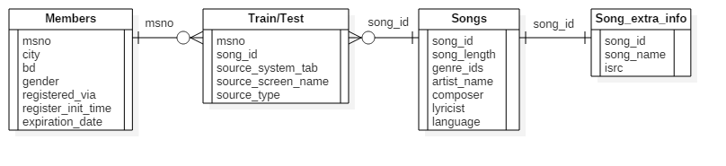
02
Used Data
Intro
duction
Used
Data
Used
Skills
Con
clusion
Data structure
Most features of data are categorical data, especially, nominal data (there is no order between categories)
Some features, kind of genre number or singer, have multi valued attribute divided by ‘|’. This means that this data set is not in first normal form.
‘Members.csv’ file is not a complete data file. Especially for age feature.
Notes:
For data analysis, we analyzed the structure of data first. On this picture, you can see the relationship between data sets. Through this, we can get 3 important points. First, most features of data are categorical data. It means that they are nominal data, so there is no order between the categories. Second, some features, including genre number and singer, have multiple values separated by a bar (|). This means that the given data set does not satisfy the first normal form. Last, members file is not a complete data file, especially for age feature.

Slide 6
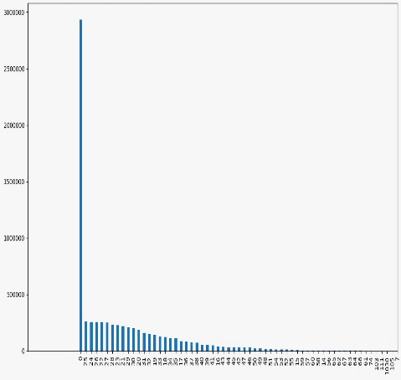
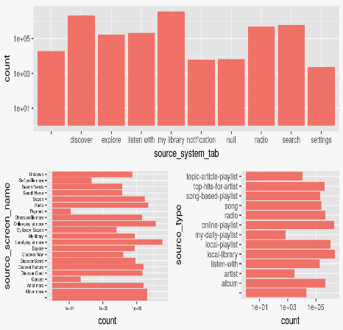
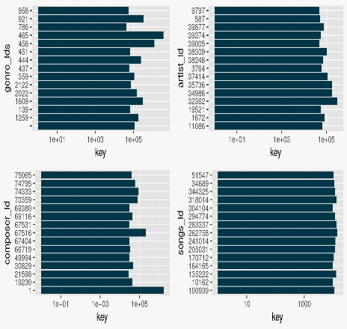
02
Used Data
Intro
duction
Used
Data
Used
Skills
Con
clusion
Data Analysis
members
train/test
songs/song_extra_info
Uncompleted data set
Show information about users
Show frequency about choice of users on menu by menu
Also on name by name and type by type
Show distribution about categories of songs by each ids
Notes:
Because of that last point, we can see a lot of users whose age is 0. That means there are many people who did not put their age information. After that, we analyzed other data sets. Through that, we were able to get information about the frequency of the method that the user approached the song. Also get distribution about categories of songs by each ids.

Slide 7
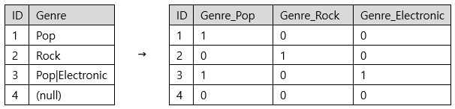
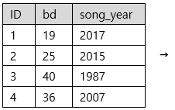
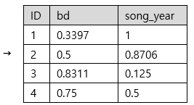
03
1. Neural Network: Data Preprocessing
Intro
duction
Used
Data
Used
Skills
Con
clusion
Categorical Features
(Dummy Features)
Conversion to Numerics
Scaling and Normalization
Nonlinear Transformation
Binary Features
Gender: Male, Female, (null) → 1, 0, 0.5
Numeric Features
Input
Layer
Hidden
Layer…
Function
Notes:
Among 3 models that we used, the first model to explain is neural network. It can only accept numbers, so the categorical features should be converted to numbers appropriately. The most frequently used method is to make dummy features, which are binary features, indicating whether the values of the feature belong to the specific category. In the case of numbers, several literatures state that it is effective to scale the numbers into the similar ranges. We adjusted the numbers in the range between 0 and 1. For some features, we applied some nonlinear transformations before scaling if they are necessary. We finally put the all features together and used as inputs of neural networks.

Slide 8
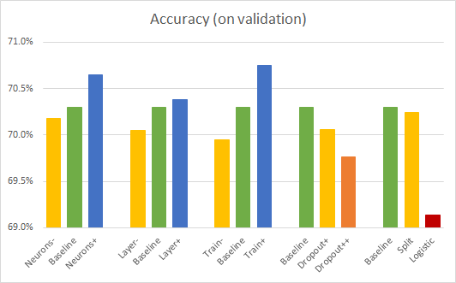
03
1. Neural Network: Results
Intro
duction
Used
Data
Used
Skills
Con
clusion
Observations:
More neurons, more layers, and more train lead to the better results.
Dropout does not produce better results.
Activation Function: The ReLU is better than the logistic function.
NNs seem to be not quite effective for problems with mostly categorical features.
Notes:
We tried several different configurations of the networks. We changed the number of neurons, the number of layers, and training time. We also applied dropouts, changed the activation function of the neurons, and split the inputs to feed them to different layers. The results show that more neurons, more layers, and more train lead to the better results. However, the dropout and the logistic activation function seems to be not working well in this project. Generally, compared to the other models, we could observe the neural networks seem to be not quite effective to the problems with many categorical features like this one.

Slide 9
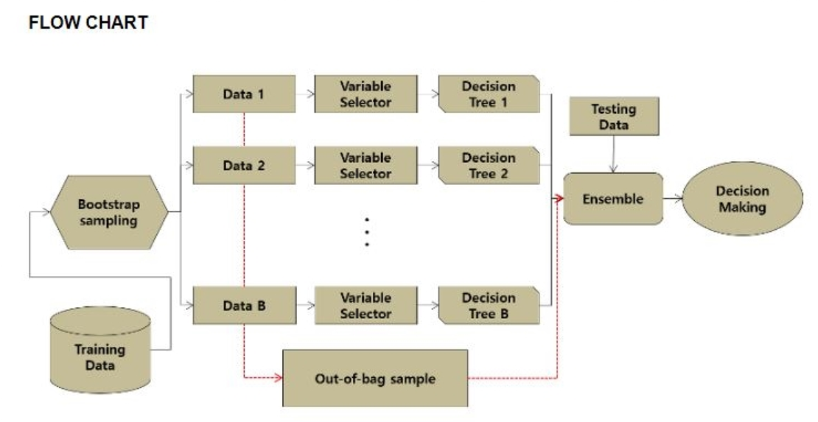
03
2. Random Forest: Algorithm
Intro
duction
Used
Data
Used
Skills
Con
clusion
Bootstrap?
- To create data of the same size as the original data by Allowing duplication in given train data.
1. Create N Bootstrap samples.
2. Create N trees with arbitrary Bootstrap samples and variables.
3. Train each trees in the ensemble.
4. Select the prediction result by voting method.
Notes:
I will explain from now on. The second model we used is Random Forest. I will explain the principle of this model briefly.
The concept you have to know before is bootstrap.
Bootstrap is to create data of the same size as the original data by Allowing duplication in given train data.
The order is as follows. We first create N bootstrap samples and use them to create N trees. Next the model trains each trees in ensemble. Then it selectes the result of the prediction as a voting method.
voting method.

Slide 10
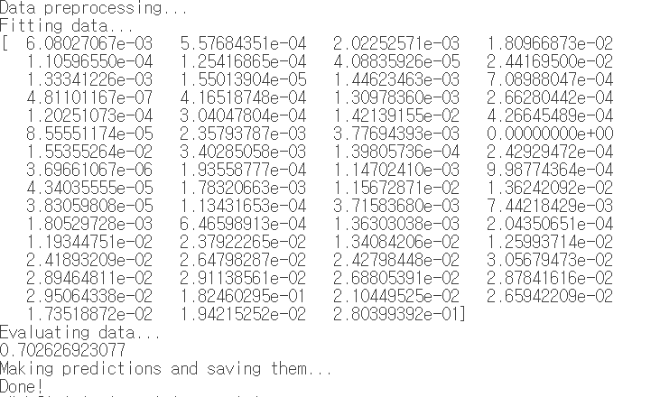
03
2. Random Forest: Results
Intro
duction
Used
Data
Used
Skills
Con
clusion
Observations:
Accuracy on validation: 70.2, Accuracy of actual test data: 64.8
Not recommended if the number of features is large.
Black boxed algorithm
-> Lost explanatory power which is advantage of decision tree
Notes:
Some data set wasn't be classified meaningfully, when using chosen features. So Random forest is not recommended if the number of features is large.
Random forest lost explanatory power which is advantage of decision tree. this is called a black boxed algorithm.

Slide 11
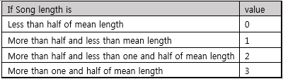
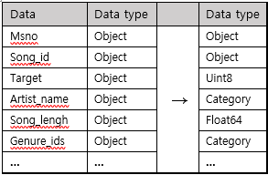
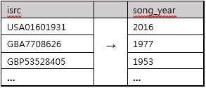
03
3. Gradient Boosting Machine: Data Preprocessing
Intro
duction
Used
Data
Used
Skills
Con
clusion
1. Data modification and type definition
2. Add features related with songs
Song_length: NA value -> mean value
Type definition
Score according to the song length
Number of times the song was played
3. Add features related with time
4. Features related with producers
1. Expiration time segmentation
2. Registration time segmentation
3. Song’s releasing year
Whether the song is featured
The number of song’s artist, composer, lyriciss
Whether the artist and the composer are the same
Whether the artist, composer, lyricist are the same
Notes:
The Third model is Gradient Boosting. What we have spent most of our time in Gradient Boosting was to add new features from the given data. This is because GBM has more accuracy as we add more valid features. The features we added can be divided into four major categories. The first is to modify incorrect data and specify type of data. For example, if NA value is found in song length data, it is replaced with average value. and then we clarifies the data type of the feature where the existing type was object.
The second is Adding features related with the song. we add score feature depending on the length of the song, Also we add the number of times the song was played.
The third is Adding features related with time. We subdivided the user's expiration time and registration time, and added the song release year using isrc which is the unique ID of the song.
The Fourth is Adding features related with song’s producers. We added features such as whether this song is featured and the number of artists, composers, lyricists and whether artists and composers are the same.

Slide 12
03
3. Gradient Boosting Machine: Results
Intro
duction
Used
Data
Used
Skills
Con
clusion
Observations:
Accuracy on validation: 80.6, Accuracy of actual test data: 68.7
Learning rate = 0.2, number of boosting = 100 is best set to our data.
Accuracy goes high when meaningful data was added.
Gradiet Boosting Machine is effective for problems with mostly categorical features.
Notes:
By using Gbm, the accuracy records eighty point six percents and the accuracy of actual test data was sixty eight point seven percent.
Important parameters of gbm are the learning rate and boosting frequency. when learning rate and boosting frequency were 0.2 and 100, The accuracy of the actual test data was highest. When we lower the the learning rate, the validation showed higher accuracy, but the actual test data showed overfitting with lower accuracy.
Also, gbm generally shows the accuracy increase when adding features. However, the accuracy of actual test data only increased when the feature was a valid.
boosting frequency.

Slide 13
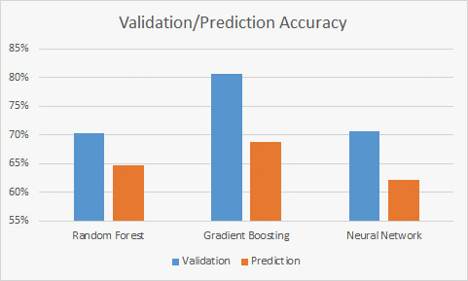
04
Conclusion
Intro
duction
Used
Data
Used
Skills
Con
clusion
Notes:
here is conclusion. We tried to solve the problem by using these three models of machine learning. the GBM was the best predictor among these models. In the case of Random Forest, the degree of overfitting was found to be lower than that of the other models. Neural networks were found to have poor prediction accuracy due to the nature of categorical data.
When we started project, we had no background on machine learning, but it was a good opportunity to deal with various data and models.
It was also impressive that we were able to analyze the large amount of customer data that the actual company had. I think this experience will be practical help for us.
nature of categorical data

Slide 14
Thank you
Notes:
Our presentation is over. Thank you for listening. Thank you.

Slide 15
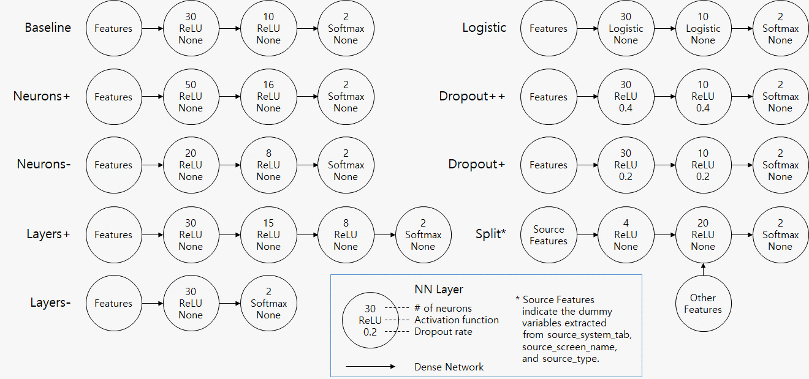
05
Appendix: Details of Neural Network Configurations
Intro
duction
Used
Data
Used
Skills
Con
clusion

